Slide 1
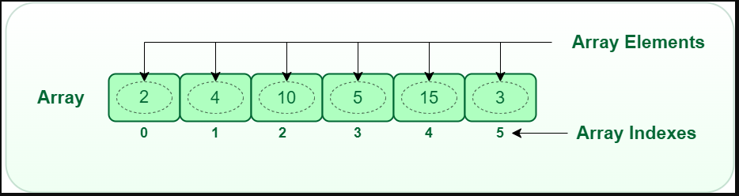
Array
Array is a linear data structure that collects elements of the same data type and stores them in contiguous and adjacent memory locations.
Index system starting from 0 to (n-1)
Fixed Size memory, Fast Access but slower in insertion and Deletion operation.
Operations possible in an array: like Searching, Sorting, Inserting, Traversing, Reversing, and Deleting.

Slide 2
Characteristics of an Array
Arrays use an index-based data structure which helps to identify each of the elements in an array easily using the index.
If a user wants to store multiple values of the same data type, then the array can be utilized efficiently.
An array can also handle complex data structures by storing data in a two-dimensional array.
An array is also used to implement other data structures like Stacks, Queues, Heaps, Hash tables, etc.
The search process in an array can be done very easily.

Slide 3
Operations performed on array
Initialization: An array can be initialized with values at the time of declaration or later using an assignment statement.
Accessing elements: Elements in an array can be accessed by their index, which starts from 0 and goes up to the size of the array minus one (0 to n-1)
Searching for elements: Arrays can be searched for a specific element using linear search or binary search algorithms.
Sorting elements: Elements in an array can be sorted in ascending or descending order using algorithms like bubble sort, insertion sort, or quick sort.
Inserting elements: Elements can be inserted into an array at a specific location, but this operation can be time-consuming because it requires shifting existing elements in the array.
Deleting elements: Elements can be deleted from an array by shifting the elements that come after it to fill the gap.
Updating elements: Elements in an array can be updated or modified by assigning a new value to a specific index.
Traversing elements: The elements in an array can be traversed in order, visiting each element once.

Slide 4
Application of Array
Storing and manipulating data: Arrays are used to store and manipulate data of the same data type. They provide a simple and efficient way to store and access large amounts of data.
Image and video processing: Arrays are used extensively in image and video processing applications. Images and videos are represented as arrays of pixels, and various operations like cropping, scaling, and filtering are performed on these arrays to manipulate the images and videos.
Scientific computing: Arrays are used in scientific computing applications like simulations and numerical computations. For example, a matrix can be represented as a 2D array, and various matrix operations like multiplication, inversion, and decomposition can be performed on the array.
Computer graphics: Arrays are used in computer graphics applications to represent geometric shapes and objects. A polygon can be represented as an array of vertices, and various operations like translation, rotation, and scaling can be performed on these arrays to manipulate the objects.
Databases: Arrays are used in databases to store and retrieve data efficiently. For example, a table in a database can be represented as a 2D array, and various operations like searching, sorting, and filtering can be performed on the array.

Slide 5
Real-Life Applications of Array
An array is frequently used to store data for mathematical computations.
It is used in image processing.
It is also used in record management.
Book pages are also real-life examples of an array.
It is used in ordering boxes as well.

Slide 6
Advantages of using arrays
Arrays allow random access to elements. This makes accessing elements by position faster.
Arrays have better cache locality which makes a pretty big difference in performance.
Arrays represent multiple data items of the same type using a single name.

Slide 7
Disadvantages of using arrays
You can’t change the size i.e. once you have declared the array you can’t change its size because of static memory allocation.
Insertion(s) and deletion(s) are difficult as the elements are stored in consecutive memory locations.
Shifting (Traversing) operation is costly too.

Slide 8
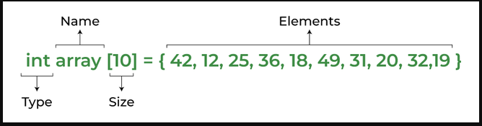
Basic terminologies of array
Array Index: In an array, elements are identified by their indexes. Array index starts from 0 to n-1.
Array element: Elements are items stored in an array and can be accessed by their index.
Array Length: The length of an array is determined by the number of elements it can contain.

Slide 9
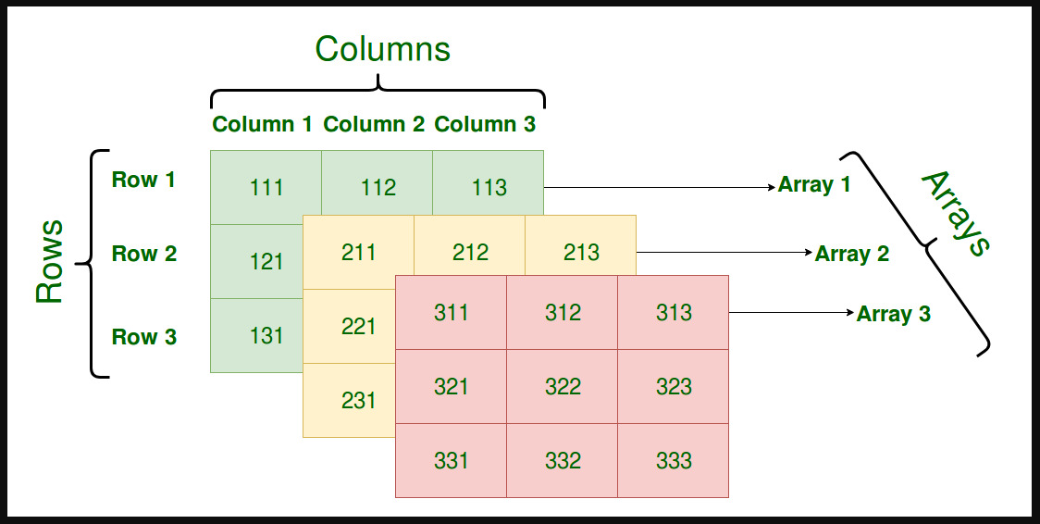
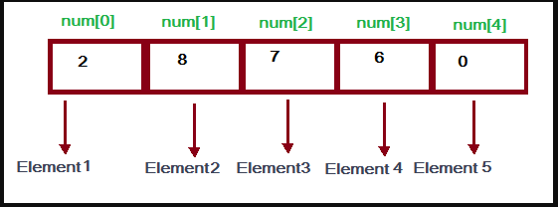
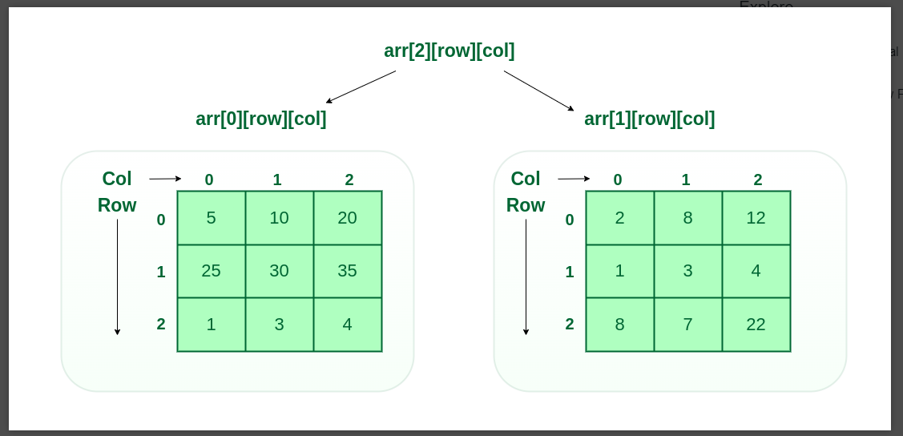
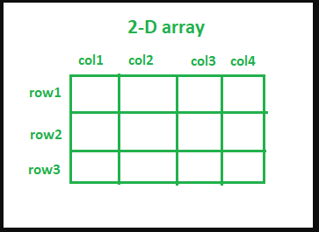
Types of Array
One Dimensional Array (1-D Array)
Two Dimensional Array (2-D Array)
Three Dimensional Array (3-D Array)

Slide 10
Types of Array operations
Traversal: Traverse through the elements of an array. It prints all array elements one after another.
Insertion: Inserting a new element in an array.
Deletion: Deleting element from the array.
Searching: Search for an element in the array.
Sorting: Maintaining the order of elements in the array.

Slide 11

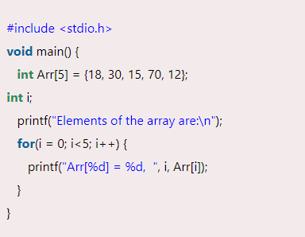
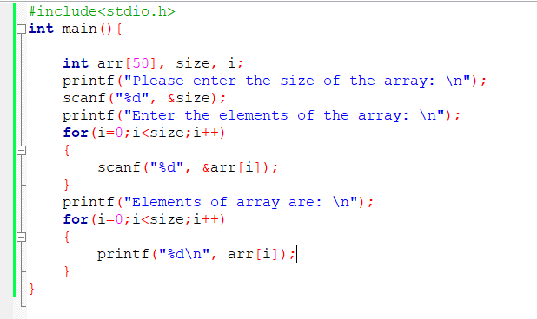
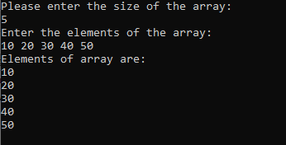
Traversal in Array
Traverse through the elements of an array. It prints all array elements one after another.

Slide 12
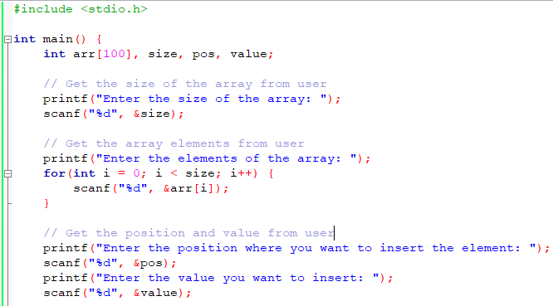
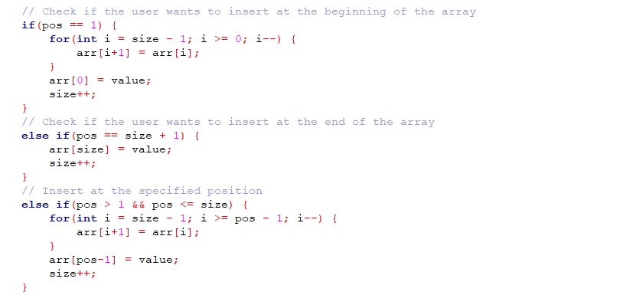
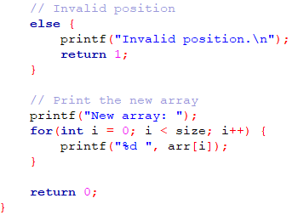
Insertion operation in Array
This operation is performed to insert one or more elements into the array.
Element can be added at the beginning, end, or at any index of the array.

Slide 13
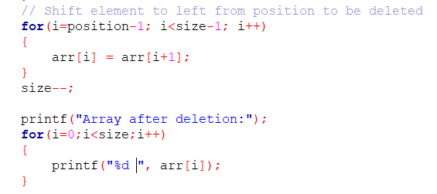
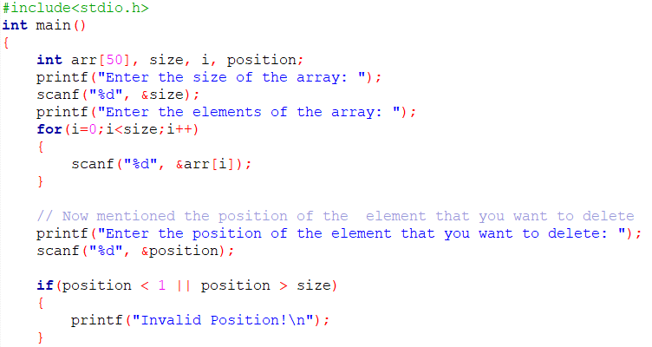
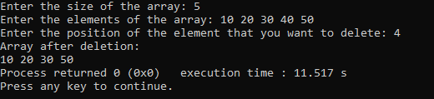
Deletion Operation in Array
This operation removes an element from the array

Slide 14
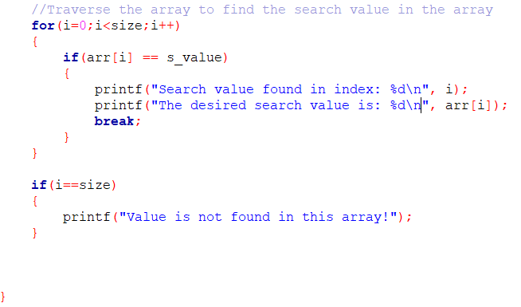
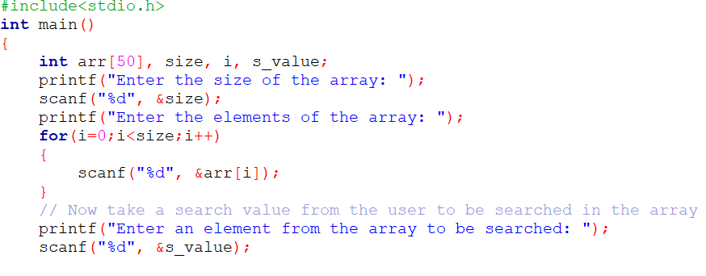
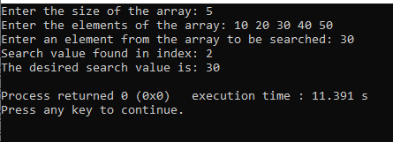
Search Operation in Array
This operation is performed to search an element in the array based on the value or index.

Slide 15
Sorting Operation in Array
There are several array-based sorting algorithm are there to perform:
Bubble Sort
Selection Sort
Insertion Sort
Quick Sort
Merge Sort
Heap Sort

Slide 16
Bubble Sort
Bubble Sort is a simple sorting algorithm that works by repeatedly swapping adjacent elements in a list until it is sorted.
Steps:
Starting at the first element of the list, compare it with the next element.
If the first element is greater than the next element, swap them.
Move on to the next pair of adjacent elements and repeat step 2 until you reach the end of the list.
At this point, the last element of the list is guaranteed to be in its correct sorted position.
Repeat steps 1-4 for the remaining elements in the list, excluding the last element that is already sorted.

Slide 17
Application of Bubble Sort
Sorting a deck of cards: Bubble sort is often used to sort a deck of cards because the deck has only 52 cards and the algorithm is simple to understand and implement.
Sorting small data sets in spreadsheet applications: Bubble sort can be used in spreadsheet applications to sort small data sets. Most spreadsheet applications have built-in sorting functions, but bubble sort can be used for small data sets that do not require complex sorting algorithms.
Sorting a playlist: Bubble sort can be used to sort a playlist of songs on a music player. This is because playlists typically have a small number of songs, and bubble sort is simple to implement.
Sorting data in embedded systems: Bubble sort can be used in embedded systems where the memory is limited, and the number of data elements is small. It requires minimal memory and can be implemented using simple hardware components, making it suitable for use in low-cost embedded systems.

Slide 18

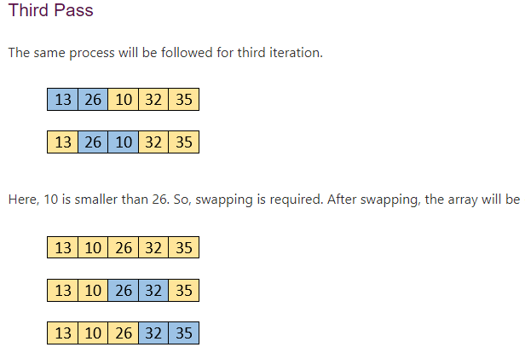
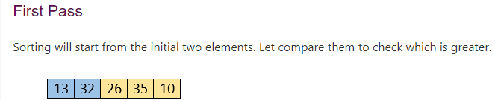

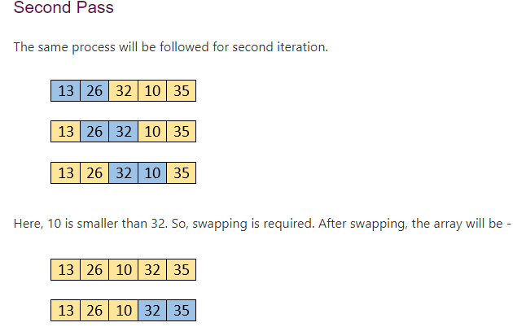
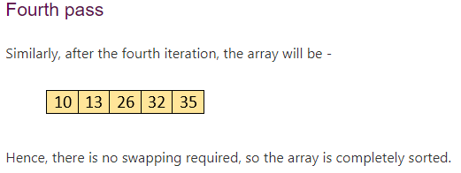

Bubble Sort

Slide 19
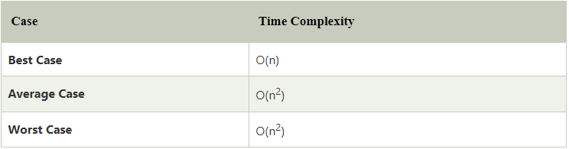
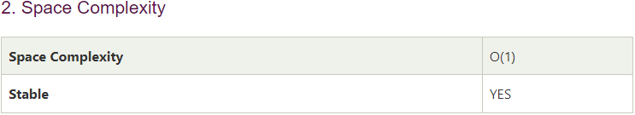
Bubble Sort
Time Complexity

Slide 20
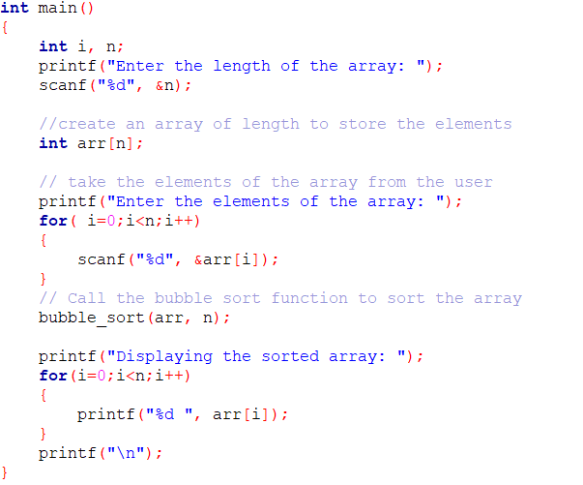
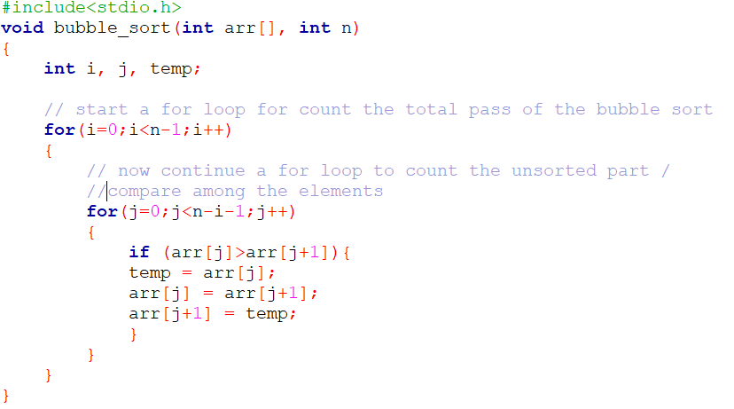

Bubble Sort Code Implementation
Output:

Slide 21
Selection Sort
Selection sort is a simple sorting algorithm that repeatedly finds the minimum element from an unsorted list and moves it to the beginning of the list.
Steps:
Find the minimum element in the unsorted list.
Swap the minimum element with the first element of the unsorted list.
Move the boundary of the unsorted list one element to the right.
The algorithm maintains two subarrays in a given array.
The subarray which already sorted.
The remaining subarray was unsorted.

Slide 22
Application of Selection Sort
Small data sets: Selection sort is ideal for sorting small data sets, where the cost of more complex sorting algorithms may outweigh the benefits. It has a time complexity of O(n^2) which is not efficient for large data sets, but for small data sets, it can be faster than more complex algorithms.
Educational purposes: Selection sort is often used in computer science courses to teach the concept of sorting algorithms. It is easy to understand and implement, and it helps students understand the basic principles of sorting algorithms.
Partial sorting: Sometimes we only need to find the minimum or maximum element in an array, and not the entire sorted array. In such cases, selection sort can be used to find the minimum or maximum element in the array by iterating through the array and selecting the minimum or maximum element at each iteration.
Memory-constrained environments: Selection sort requires minimal memory overhead since it does not require any additional data structures to perform the sorting operation.

Slide 23

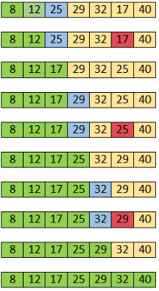
Selection Sort
At present, 12 is stored at the first position, after searching the entire array, it is found that 8 is the smallest value. So, swap 12 with 8. After the first iteration, 8 will appear at the first position in the sorted array.
For the second position, where 29 is stored presently, we again sequentially scan the rest of the items of unsorted array. After scanning, we find that 12 is the second lowest element in the array that should be appeared at second position.
Now, swap 29 with 12. After the second iteration, 12 will appear at the second position in the sorted array. So, after two iterations, the two smallest values are placed at the beginning in a sorted way.
The same process is applied to the rest of the array elements. Now, we are showing a pictorial representation of the entire sorting process.

Slide 24
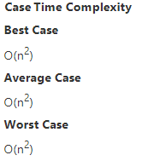
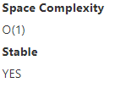
Selection Sort
Time Complexity:
Space Complexity:

Slide 25
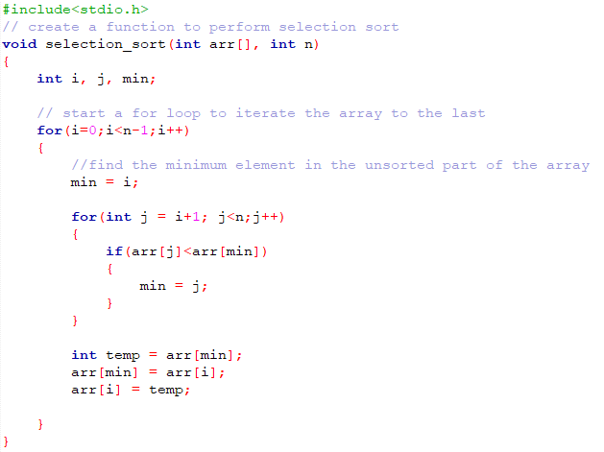
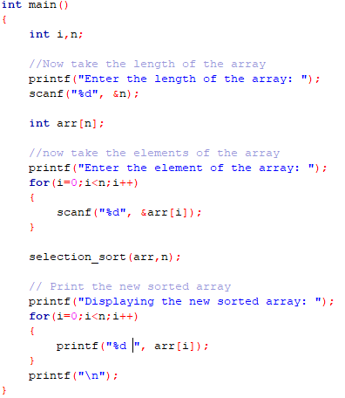

Selection Sort
Output:

Slide 26
Insertion Sort
Insertion sort is a simple sorting algorithm that works by building the final sorted array one item at a time. It is much less efficient on large lists than more advanced algorithms such as quicksort, heapsort, or merge sort.
Steps:
Assume the first element in the list is already sorted, and start with the second element.
Compare the second element with the first element. If the second element is smaller, swap the two elements.
Move on to the third element, and compare it with the second element. If the third element is smaller than the second element, swap them. Then, compare the new second element with the first element, and swap them if necessary.
Repeat this process for all subsequent elements in the list, comparing each one with the elements that come before it and swapping if necessary.
At the end of the process, the list should be sorted.

Slide 27
Insertion Sort
It has several advantages, including:
Simple implementation
Efficient for small data sets
Adaptive - it can sort a list while it is being received
Application of Insertion Algorithm:
Sorting Decks of Cards: Insertion sort is often used to sort decks of cards in games like poker or bridge. This is because the number of cards in a deck is relatively small (typically 52 cards), and the cards are often nearly sorted after a shuffle.
Sorting Names in an Address Book: Insertion sort can be used to sort names in an address book. This is because the number of names is usually small, and the names are typically in alphabetical order, so only a few swaps are needed to sort the list.
Maintaining a List of High Scores: Insertion sort can be used to maintain a list of high scores in a video game. As new scores are added to the list, insertion sort can be used to keep the list in descending order, so that the highest scores are always at the top.
Online Sorting: Insertion sort is an online sorting algorithm, which means that it can sort data as it is received. This makes it useful in situations where data is arriving in real-time and needs to be sorted immediately.
Building a Huffman Tree: Insertion sort can be used to build a Huffman tree, which is a data structure used in lossless data compression. The algorithm sorts a list of nodes by their frequency, which is used to build the Huffman tree.

Slide 28

Insertion Sort
Initially, the first two elements are compared in insertion sort.
Here, 31 is greater than 12. That means both elements are already in ascending order.
So, for now, 12 is stored in a sorted sub-array. Now, move to the next two elements and compare them.
Here, 25 is smaller than 31. So, 31 is not at correct position. Now, swap 31 with 25. Along with swapping,
insertion sort will also check it with all elements in the sorted array.
For now, the sorted array has only one element, i.e. 12. So, 25 is greater than 12.
Hence, the sorted array remains sorted after swapping.
Now, two elements in the sorted array are 12 and 25. Move forward to the next elements that
are 31 and 8.Both 31 and 8 are not sorted. So, swap them. After swapping, elements 25 and 8 are unsorted.
So, swap them. Now, elements 12 and 8 are unsorted.
So, swap them too. Now, the sorted array has three items that are 8, 12 and 25.
Move to the next items that are 31 and 32.
Hence, they are already sorted. Now, the sorted array includes 8, 12, 25 and 31.
Move to the next elements that are 32 and 17. 17 is smaller than 32.
So, swap them. Swapping makes 31 and 17 unsorted. So, swap them too.
Now, swapping makes 25 and 17 unsorted. So, perform swapping again.
Now, the array is completely sorted.

Slide 29
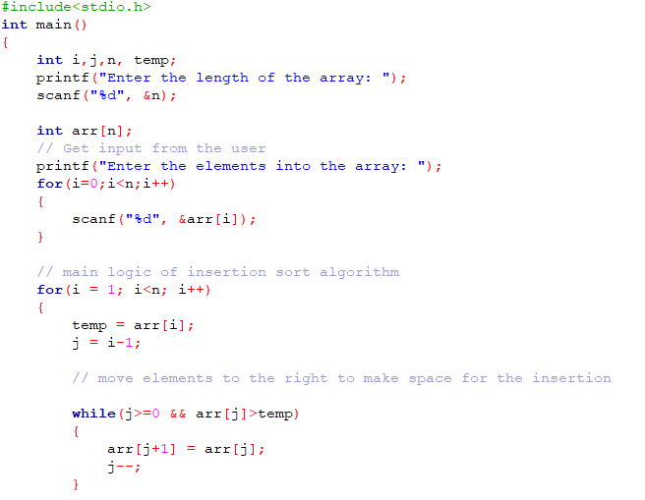
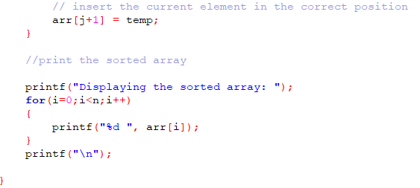

Insertion Sort
Output:

Slide 30
Quick Sort

